Slide 1

2019 Hong Kong Horse Racing Cluster Analysis

Slide 2
Agenda
Introduce Hong Kong 2019 horse racing concept and data
Describe the clustering process
Interpret cluster membership
Present conclusions/limitations/ further future analysis

Slide 3
Why Horse racing in Hong Kong
Hong Kong has two racetracks in a city that is only 1,104 square km
The Hong Kong Jockey Club conducts nearly 700 horse races per year
The betting pools are bigger than all US racetracks combined
Horse racing is a huge business in Hong Kong

Slide 4
About the data
Data was collected over the 2019 Hong Kong horseracing season
Nearly 70,000 entries on 4215 different horses
The dataset was obtained from Kaggle. The user made the data set from various free sources and was presented in CSV format

Slide 5
About the clustering process
Only numerical and ordinal data was used for the clustering process
Size of data limited types of cluster methods tried
Different number of clusters tied
Kmeans with 6 clusters was ultimately used

Slide 6
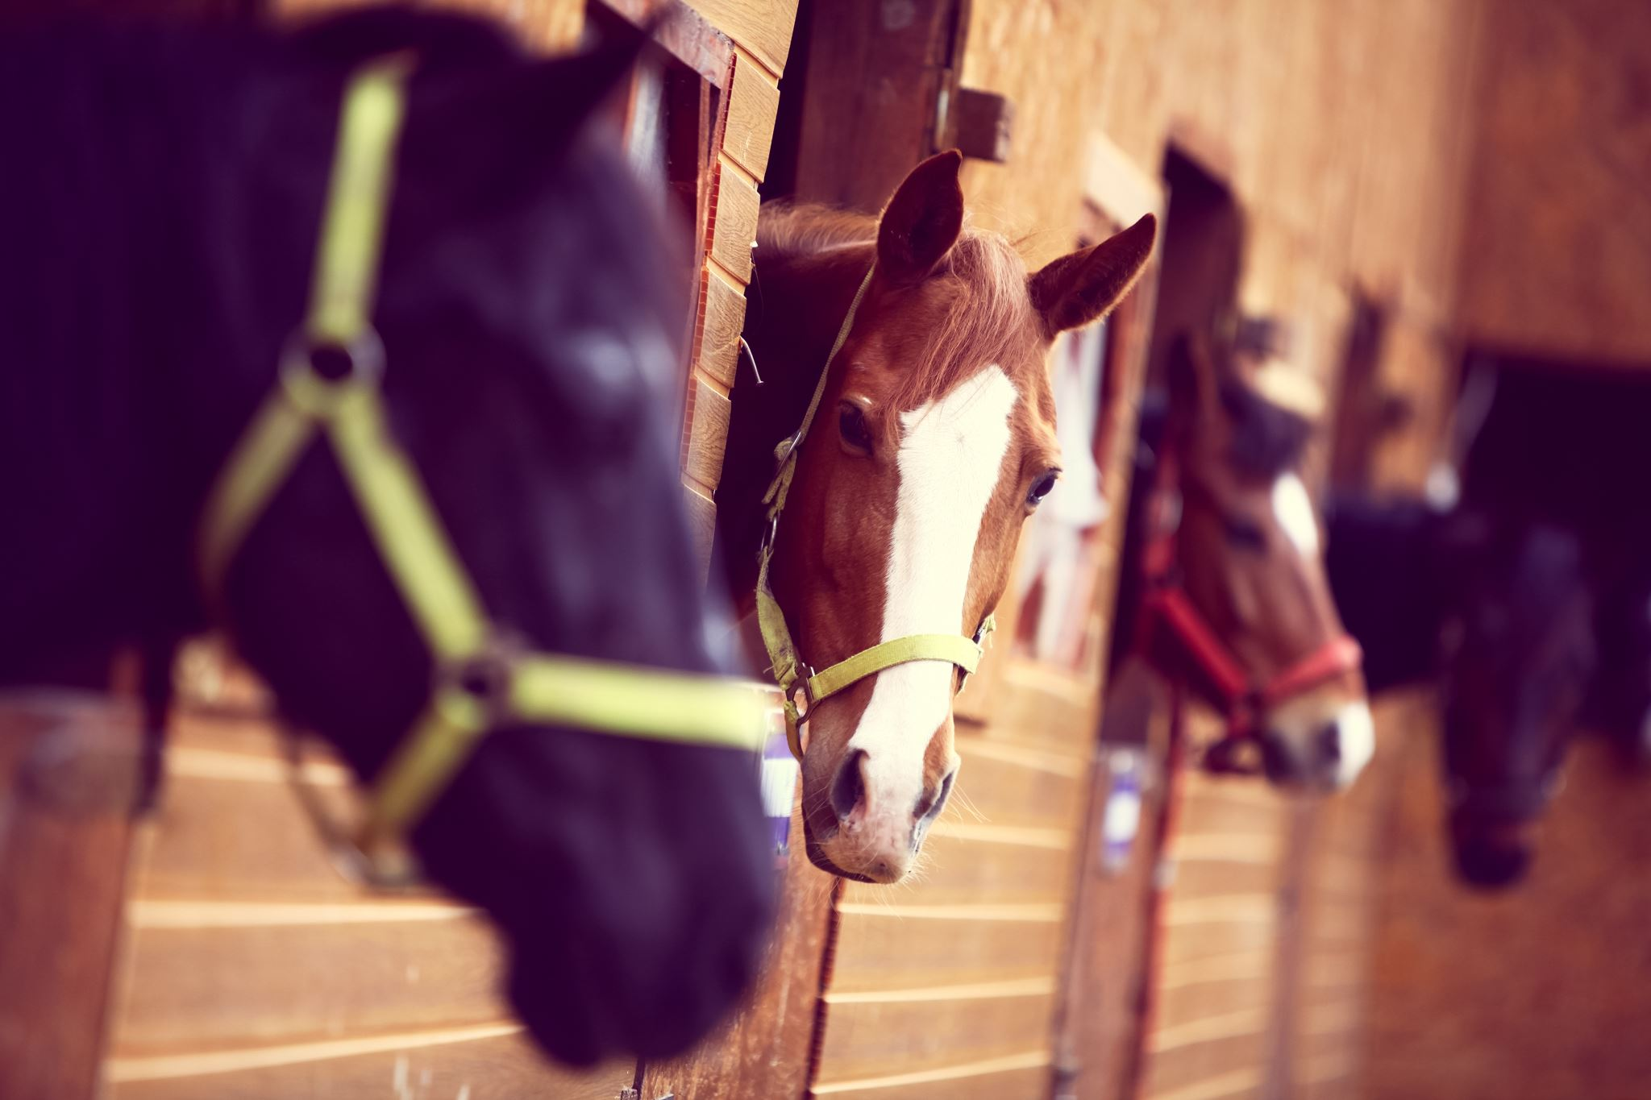
About the clustering process numerical data examples
Horse age
Distance of race
Time to complete race/ proportion of race
Actual weight (weight of horse)
Declared weight (weight of horse plus jockey)

Slide 7
About the clustering process ordinal data examples
Going (track condition)
Horse Rating (horse class)
Result in Race
Going turf track | Going all weather track (dirt)
1 Firm | 1 Fast
2 Good to Firm | 2 Wet Fast (if rain)
3 Good | 3 Good
4 Good to Yeilding
5 Yielding | 5 Slow
6 Yielding to Soft | 6 Wet Slow (if rain)
7 Soft

Slide 8
About the clustering process Missing Data
Horse equipment was mostly missing. However the hong kong jockey club has a list of approved racing gear and standards so most of the time equipment is the same. Differences are minor like an extra bandage so this column was diregarded https://racing.hkjc.com/racing/english/racing-info/rules_pdf/Equipment-Register-Full-English.pdf
Other missing data was less then 5% and the rows were dropped

Slide 9
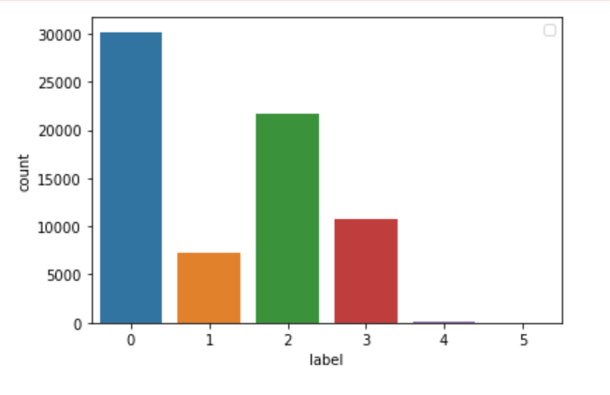
Cluster Analysis
Cluster Label | Size of Cluster
0 | 30,173
1 | 7241
2 | 21,694
3 | 10,700
4 | 52
5 | 1

Slide 10
Cluster 4 and 5 same cluster New to racing and didn’t make it through the season cluster
Cluster 5 horse had only one race
Cluster 4 horses had significantly less races then the other clusters
Cluster 4 and 5 horses 2-3 years old only
Cluster 4 and 5 never won any races

Slide 11
Cluster 1 (dirt races at Shatin)
Cluster 1 seems to have sorted out the majority of the dirt course races
Cluster label | turf | dirt
0 | 30173 | 0
1 | 0 | 7241
2 | 21694 | 0
3 | 10314 | 386
4 | 43 | 9
5 | 1 | 0
Cluster label | Happy Valley | Shatin
0 | 10395 | 19778
1 | 0 | 7241
2 | 11581 | 10113
3 | 2300 | 8400
4 | 20 | 32
5 | 1 | 0

Slide 12
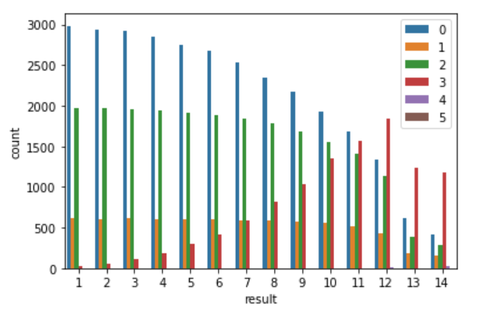
Cluster analysis race result
Cluster label | loss | won | Win %
0 | 27189 | 2984 | 10
1 | 6629 | 612 | 8
2 | 19722 | 1972 | 9
3 | 10672 | 28 | < 1
4 | 52 | 0 | 0
5 | 1 | 0 | 0

Slide 13
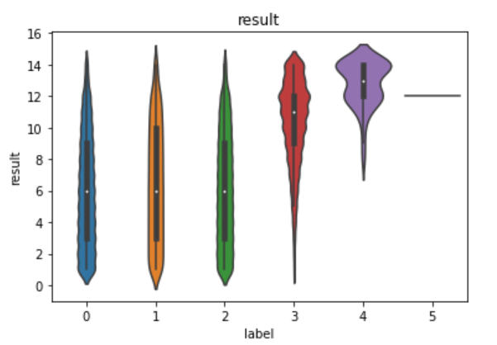
Cluster analysis race result continued
Cluster 1and 2 teardropish shape
Cluster 3 tail heavy losses

Slide 14
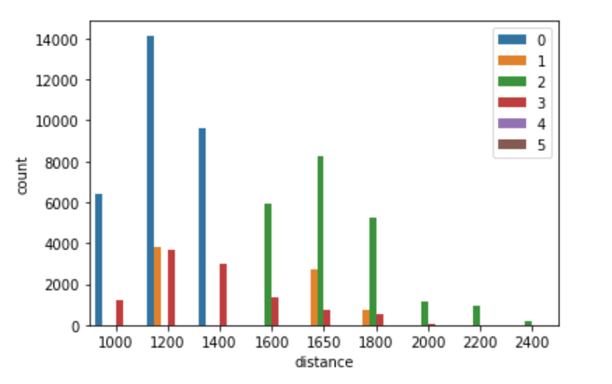
Cluster Analysis distance
Win% at each distance
Distance | Cluster 0 | Cluster 2 | Cluster 3
1000 | 9.80% | .08% | 0%
1200 | 10.08% | 0% | .19%
1400 | 9.68% | 0% | .33%
1600 | 0% | 9.32% | .43%
1650 | 0% | 9.10% | .42%
1800 | NaN | 8.93% | .18%
2000 | NaN | 8.61% | 0%
2200 | NaN | 8.93% | 0%
2400 | NaN | 9.71% | 0%

Slide 15
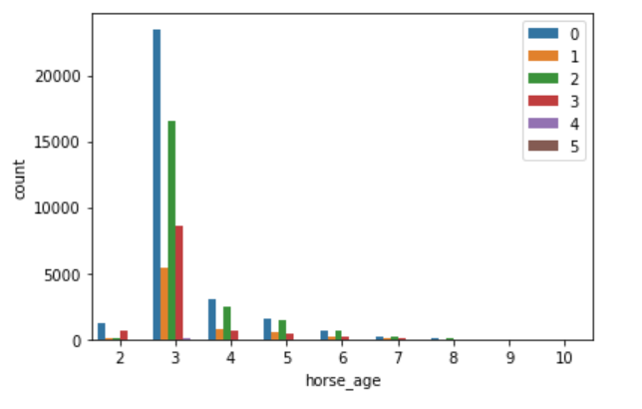
Cluster Analysis Age
Horse age by cluster group
 | 2 | 3 | 4 | 5 | 6 | 7 | 8 | 9 | 10
0 | 1221 | 23486 | 3001 | 1553 | 612 | 222 | 66 | 9 | 3
2 | 138 | 16561 | 2475 | 1505 | 669 | 261 | 64 | 21 | 0
3 | 635 | 8621 | 660 | 405 | 262 | 96 | 21 | 0 | 0

Slide 16
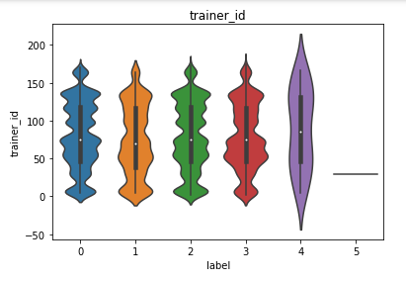
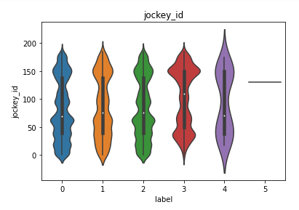
Cluster Analysis Jockey and trainer

Slide 17
Cluster Analysis Top 5 Jockeys & Trainers
Top 5 jockeys
Top 5 trainers
Cluster Label | % of horses rode
0 | 53
2 | 37
3 | 10
4 & 5 | 0
Cluster Label | % of horses trained
0 | 50
2 | 37
3 | 13
4 & 5 | approximately 0

Slide 18
Cluster Analysis Conclusion
LIMTATIONS: no sire/dam history
FURTHER ANALYSIS: cluster 1
CONCLUSION:
Cluster 0 “Sprinter Horses”
Cluster 1 “Dirt Races”
Cluster 2 “Distance Horses
Cluster 3 “Longshot Horses”
Cluster 4&5 “broke horses”

